Slide 1

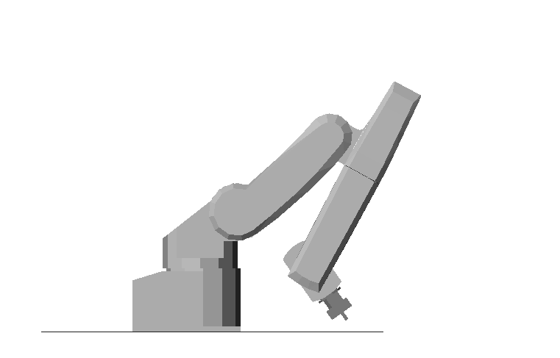
obots
Training Manual
For Beginners

Slide 2
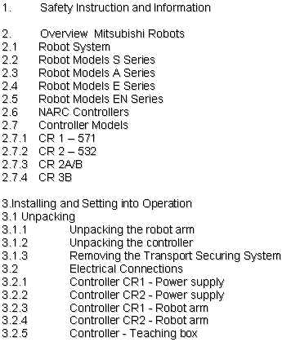
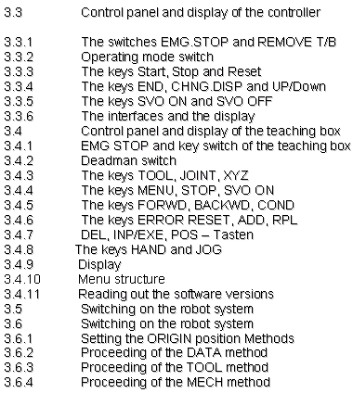
Table of Contents

Slide 3
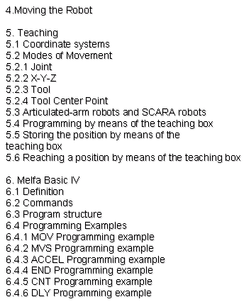
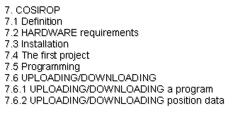
Table of Contents

Slide 4
1. Safety Instruction and Information

Slide 5
Safety Instruction and Information
In the examples under practical service conditions the robot‘s movements are carried out without the necessary safety devices.
Please observe the necessary safe distance from the robot system. To take program executions is allowed then only, when the trainer is present.
- Thanks for your understanding. -

Slide 6
2. Overview
Mitsubishi Robots

Slide 7
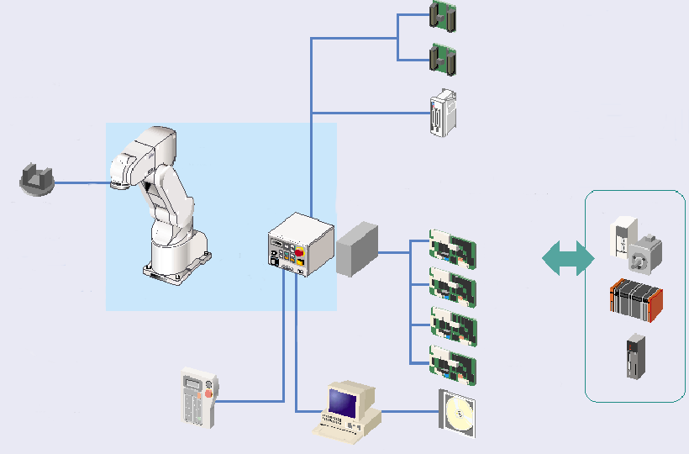
2.1 Robot System
Hand interface
Robot arm
Expansion I/O
Hand
Controller
Expansion box
Servo motor
Ethernet
interface
CC-Link
interface
Additional serial
interface
PLC
Teaching box
Additional axis
control interface
Vision sensor
Support software
COSIROP / COSIMIR

Slide 8
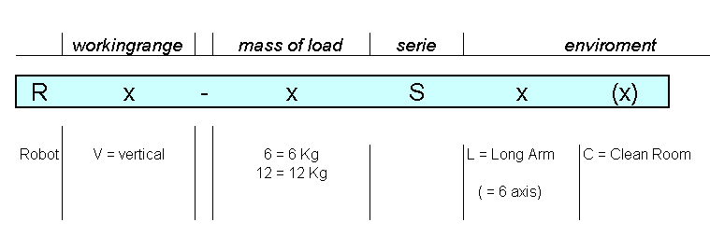
2.2 Robot Models
S Series

Slide 9
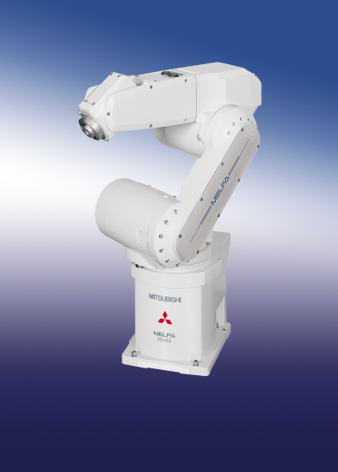
RV-6S
6 DOF robot
Robot arm:
Reach 696mm
Repeatability ±0.02mm
Maximum payload 6kg
Maximum speed 9.300mm/s
Multitasking operating system:
Maximum tasks 32
Maximum program lines 5.000
Maximum position points 2.500
Programs 88
Maximum digital I/Os 256 I/256 O
Power supply 180V-253V AC

Slide 10
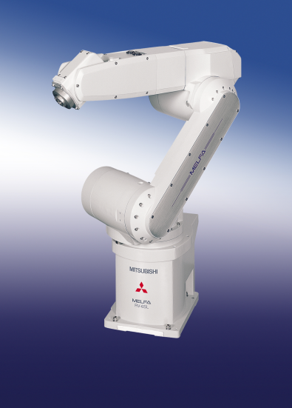
RV-6SL
6 DOF robot
Robot arm:
Reach 902mm
Repeatability ±0.02mm
Maximum payload 6kg
Maximum speed 8.500mm/s
Multitasking operating system:
Maximum tasks 32
Maximum program lines 5.000
Maximum position points 2.500
Programs 88
Maximum digital I/Os 256 I/256 O
Power supply 180V-253V AC

Slide 11
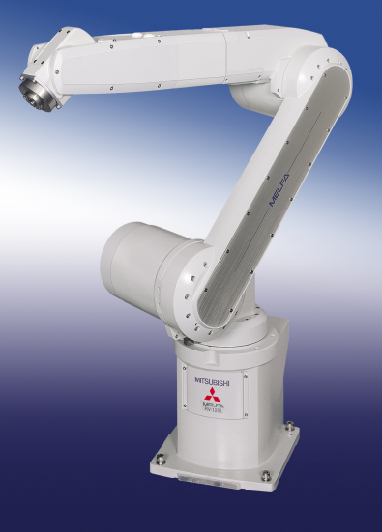
RV-12SL
6 DOF robot
Robot arm:
Reach 1385mm
Repeatability ±0.05mm
Maximum payload 12kg
Maximum speed 9.500mm/s
Multitasking operating system:
Maximum tasks 32
Maximum program lines 5.000
Maximum position points 2.500
Programs 88
Maximum digital I/Os 256 I/256 O
Power supply 180V-253V AC

Slide 12
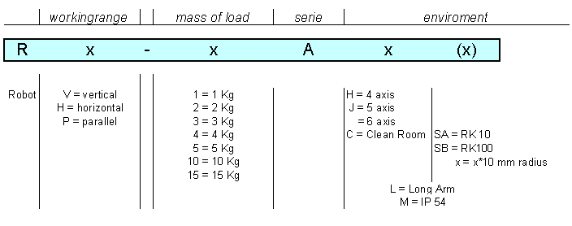
2.3 Robot Models
A Series

Slide 13
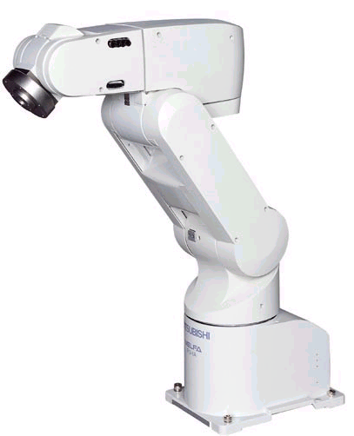
RV-1A
6 DOF robot
Robot arm:
Reach 418mm
Repeatability ±0.02mm
Maximum payload 1kg
Maximum speed 2.200mm/s
Multitasking operating system:
Maximum tasks 32
Maximum program lines 5.000
Maximum position points 2.500
Programs 88
Maximum digital I/Os 240 I/240 O
Power supply 170V-253V AC

Slide 14
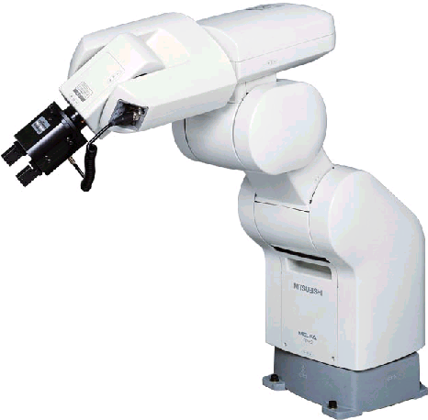
RV-2A
6 DOF robot
Robot arm:
Reach 621mm
Repeatability ±0.04mm
Maximum payload 2kg
Maximum speed 3.500mm/s
Multitasking operating system:
Maximum tasks 32
Maximum program lines 5.000
Maximum position points 2.500
Programs 88
Maximum digital I/Os 240 I/240 O
Power supply 170V-253V AC

Slide 15
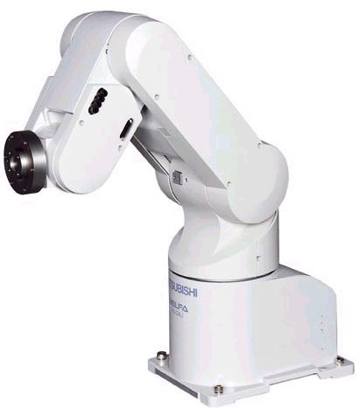
RV-2AJ
5 DOF robot
Robot arm:
Reach 410mm
Repeatability ±0.02mm
Maximum payload 2kg
Maximum speed 2.100mm/s
Multitasking operating system:
Maximum tasks 32
Maximum program lines 5.000
Maximum position points 2.500
Programs 88
Maximum digital I/Os 240 I/240 O
Power supply 170V-253V AC

Slide 16
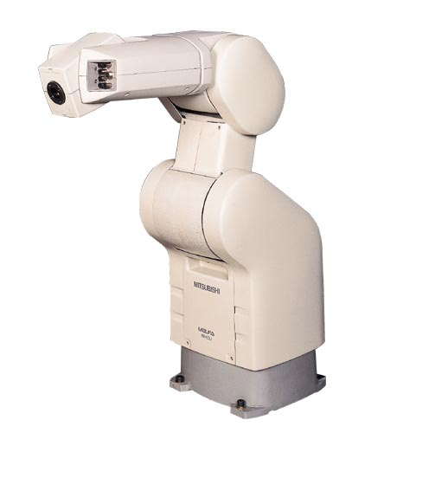
RV-3AJ
5 DOF robot
Robot arm:
Reach 630mm
Repeatability ±0.04mm
Maximum payload 3kg
Maximum speed 3.500mm/s
Multitasking operating system:
Maximum tasks 32
Maximum program lines 5.000
Maximum position points 2.500
Programs 88
Maximum digital I/Os 240 I/240 O
Power supply 170V-253V AC

Slide 17
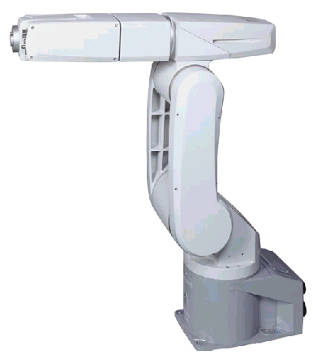
RV-3AL
6 DOF robot
Robot arm:
Reach 843mm
Repeatability ±0.04mm
Maximum payload 3kg
Maximum speed 6.000mm/s
Multitasking operating system:
Maximum tasks 32
Maximum program lines 5.000
Maximum position points 2.500
Programs 88
Maximum digital I/Os 256 I/256 O
Power supply 170V-253V AC
Applications:
- Palletising components
- Loading and unloading
- Removing components

Slide 18
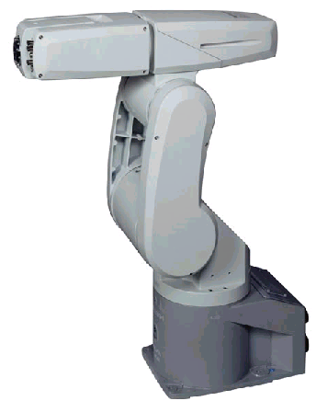
RV-4A
6 DOF robot
Robot arm:
Reach 634mm
Repeatability ±0.03mm
Maximum payload 4kg
Maximum speed 5.800mm/s
Multitasking operating system:
Maximum tasks 32
Maximum program lines 5.000
Maximum position points 2.500
Programs 88
Maximum digital I/Os 256 I/256 O
Power supply 180V-253V AC

Slide 19
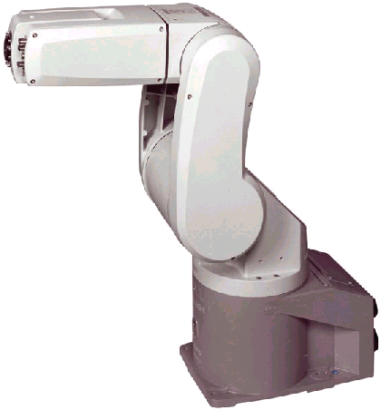
RV-5AJ
5 DOF robot
Robot arm:
Reach 630mm
Repeatability ±0.03mm
Maximum payload 5kg
Maximum speed 5.700mm/s
Multitasking operating system:
Maximum tasks 32
Maximum program lines 5.000
Maximum position points 2.500
Programs 88
Maximum digital I/Os 256 I/256 O
Power supply 170V-253V AC

Slide 20
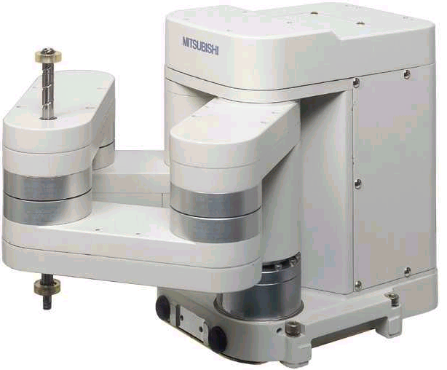
RP-1AH
4 DOF robot
Robot arm:
Reach 332mm
Rectangular work space DIN A6
Repeatability ±0.005mm
Maximum payload 1kg
Cycle period 20-100-20 <0.4s
Multitasking operating system:
Maximum tasks 32
Maximum program lines 5.000
Maximum position points 2.500
Programs 88
Maximum digital I/Os 240 I/240 O
Power supply 170V-253V AC
Applications:
- High-precision placement
Fields:
- IT, semiconductors,
watch-and-clock-making industry
- Placement of SMD circuit boards

Slide 21
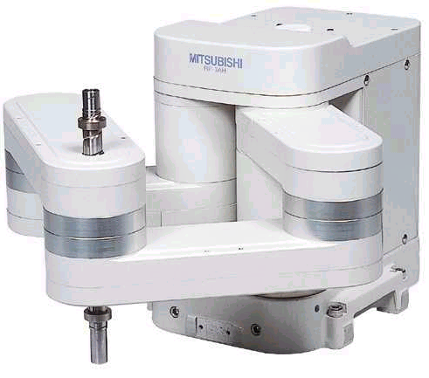
RP-3AH
4 DOF robot
Robot arm:
Reach 332mm
Rectangular work space DIN A5
Repeatability ±0.008mm
Maximum payload 3kg
Cycle period 20-100-20 0.45s
Multitasking operating system :
Maximum tasks 32
Maximum program lines 5.000
Maximum position points 2.500
Programs 88
Maximum digital I/Os 240 I/240 O
Power supply 170V-253V AC
Applications:
- High-precision placement
Fields:
- IT, semiconductors,
watch-and-clock-making industry
- Placement of SMD circuit boards

Slide 22
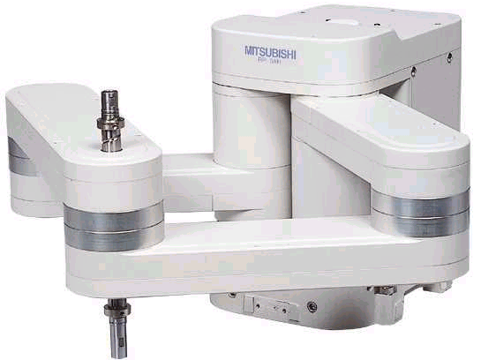
RP-5AH
4 DOF robot
Robot arm:
Reach 451mm
Rectangular work space DIN A4
Repeatability ±0.01mm
Maximum payload 5kg
Cycle period 20-100-20 0.5s
Multitasking operating system:
Maximum tasks 32
Maximum program lines 5.000
Maximum position points 2.500
Programs 88
Maximum digital I/Os 240 I/240 O
Power supply 170V-253V AC
Applications:
- High-precision placement
Fields:
- IT, semiconductors,
watch-and-clock-making industry
- Placement of SMD circuit boards

Slide 23
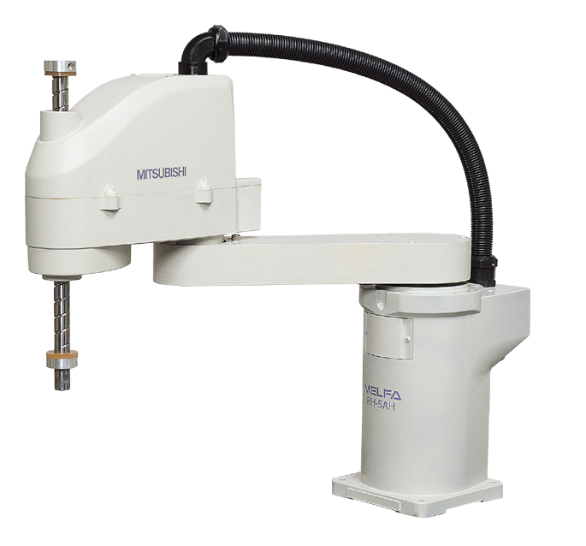
RH-5AH35/45/55
4 DOF robots
Robot arm:
Reach 350/450/550mm
Repeatability ±0.02mm
Maximum payload 5kg
Cycle period 20-100-20 0.5s
Multitasking operating system :
Maximum tasks 32
Maximum program lines 5.000
Maximum position points 2.500
Programs 88
Maximum digital I/Os 256 I/256 O
Power supply 170V-253V AC
Applications:
- Palletising components
- Coating surfaces
- Deburring
- Removing components

Slide 24
RH-10AH55/70/85
4 DOF robots
Robot arm:
Reach 550/700/850mm
Repeatability ±0.02/0.025/0.025mm
Maximum payload 10kg
Cycle period 20-100-20 0.49/0.5/0.52s
Multitasking operating system:
Maximum tasks 32
Maximum program lines 5.000
Maximum position points 2.500
Programs 88
Maximum digital I/Os 256 I/256 O
Power supply 170V-253V AC
Applications:
- Palletising components
- Coating surfaces
- Deburring
- Removing components

Slide 25
RH-15AH85
4 DOF robot
Robot arm:
Reach 850mm
Repeatability ±0.025mm
Maximum payload 15kg
Cycle period 20-100-20 0.57s
Multitasking operating system:
Maximum tasks 32
Maximum program lines 5.000
Maximum position points 2.500
Programs 88
Maximum digital I/Os 256 I/256 O
Power supply 170V-253V AC
Applications:
- Palletising components
- Coating surfaces
- Deburring
- Removing components

Slide 26
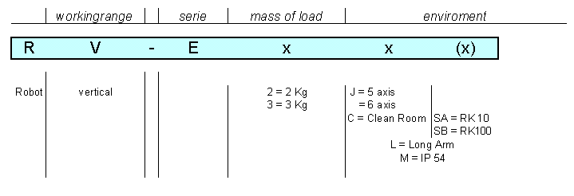
2.4 Robot Models
E Series

Slide 27
RV-E2
6 DOF robot
Robot arm:
Reach 621mm
Repeatability ±0.04mm
Maximum payload 2kg
Maximum speed 3.500mm/s
Multitasking operating system:
Maximum tasks 1
Maximum program lines 4.000
Maximum position points 999
Programs 31
Maximum digital I/Os 48 I/60 O
Power supply 180V-253V AC

Slide 28
RV-E3J
5 DOF robot
Robot arm:
Reach 630mm
Repeatability ±0.04mm
Maximum payload 3kg
Maximum speed 3.500mm/s
Multitasking operating system:
Maximum tasks 1
Maximum program lines 4.000
Maximum position points 999
Programs 1
Maximum digital I/Os 48 I/60 O
Power supply 180V-253V AC

Slide 29
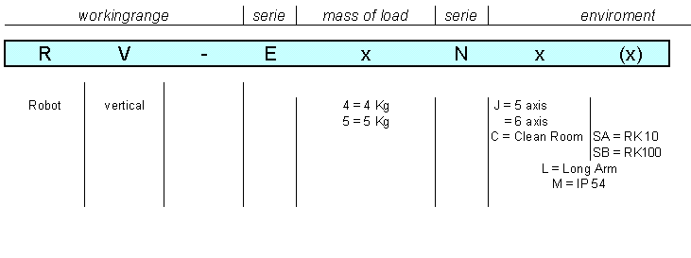
2.5 Robot Models
EN Series

Slide 30
2.6 NARC Controllers
N - New
A - Architecture
R - Robot
C - Controller
NARC presents a new generation of robot controllers. This structure makes it possible to control all Mitsubishi robots by one controller model. There are only two controller sizes. For all robots the basic controller structure, the options, connections, programming etc. are identical.

Slide 31
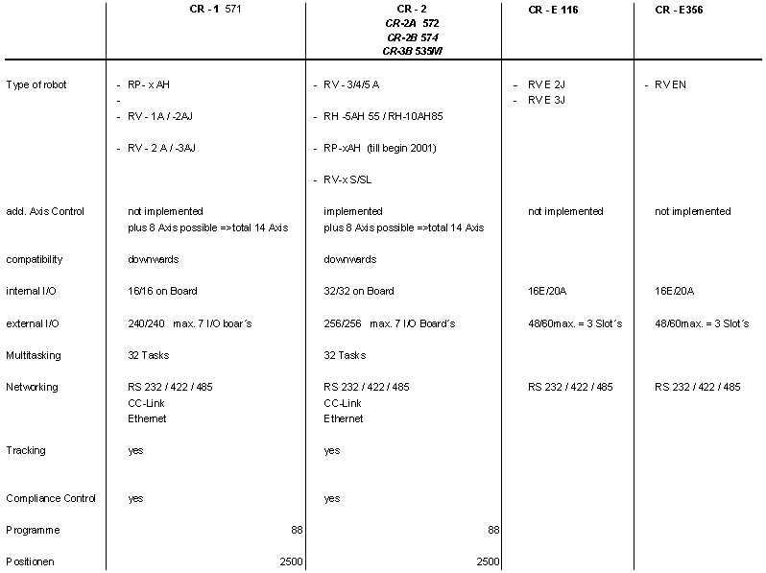
2.7 Controller Models

Slide 32
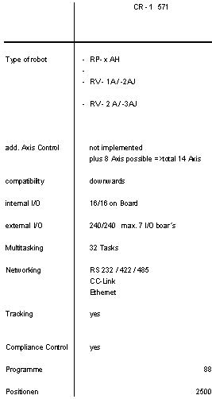
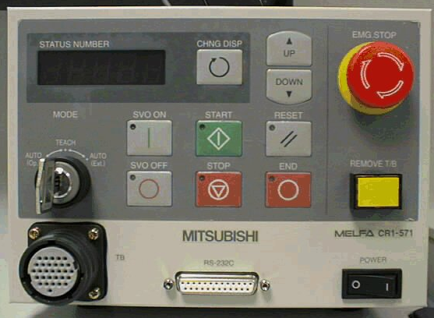
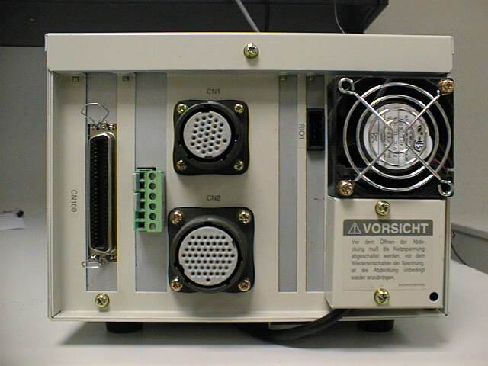
2.7.1 CR 1 - 571
Front view
Rear view

Slide 33
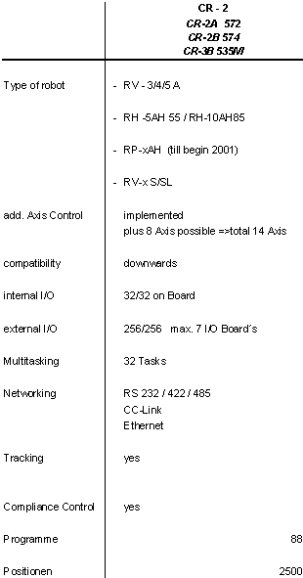
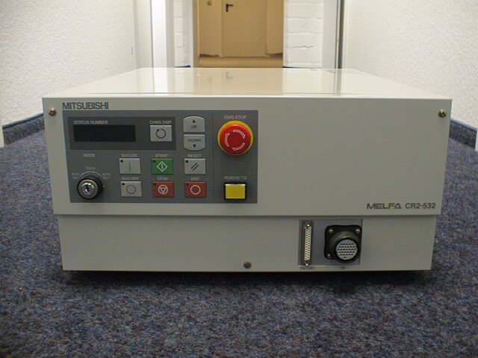
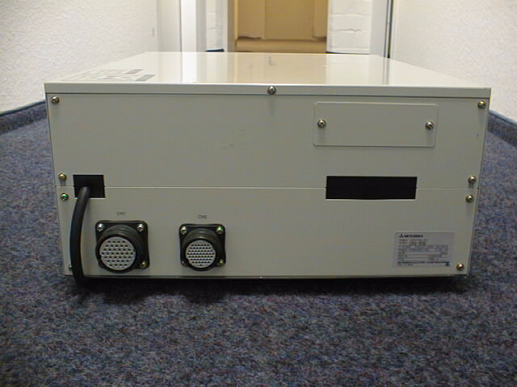
2.7.2 CR 2 - 532
Front view
Rear view

Slide 34
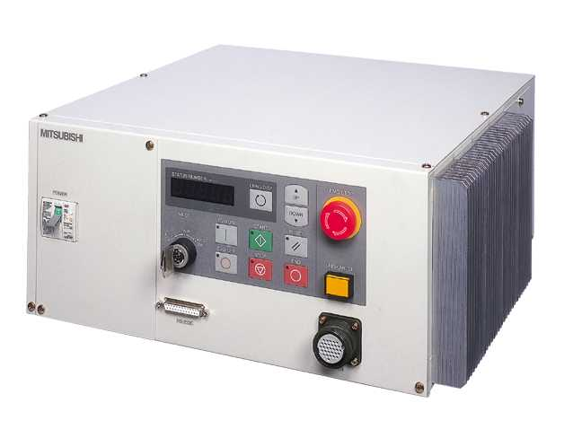
2.7.3 CR 2A/B

Slide 35
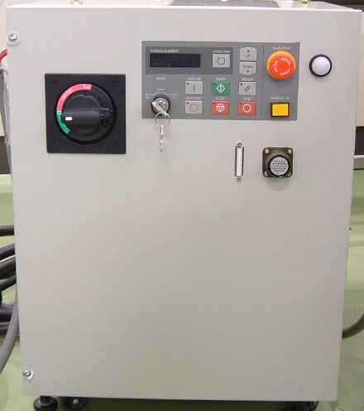
2.7.4 CR 3B

Slide 36
3.Installing and Setting into Operation

Slide 37

Safety Information
In any case you have to observe the safety information of the respective robot.
You find the safety information in the delivered manuals.

Slide 38
3.1 Unpacking

Slide 39
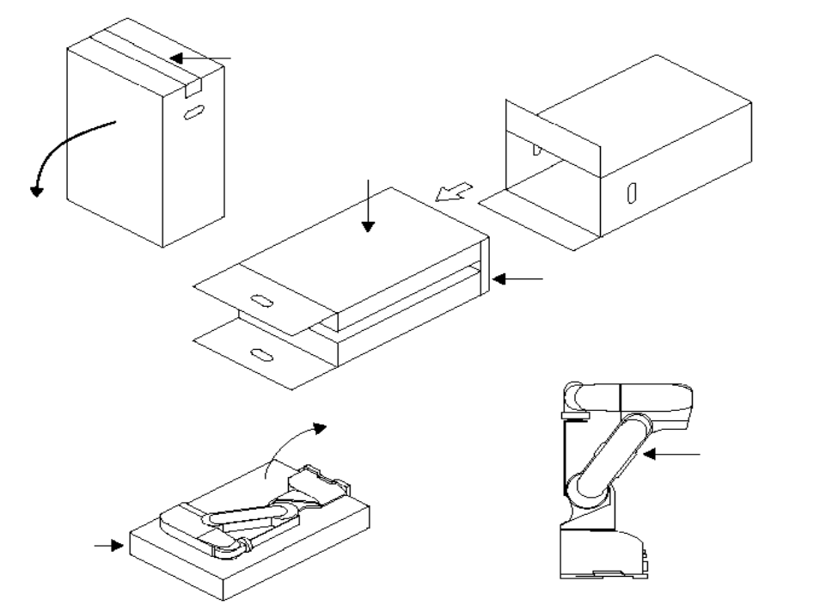
3.1.1 Unpacking the robot arm
The robot must be unpacked following step 1 to step 7.
1
4
2
3
6
7
5
In case of other robot models, please pay attention to the respective manual!

Slide 40
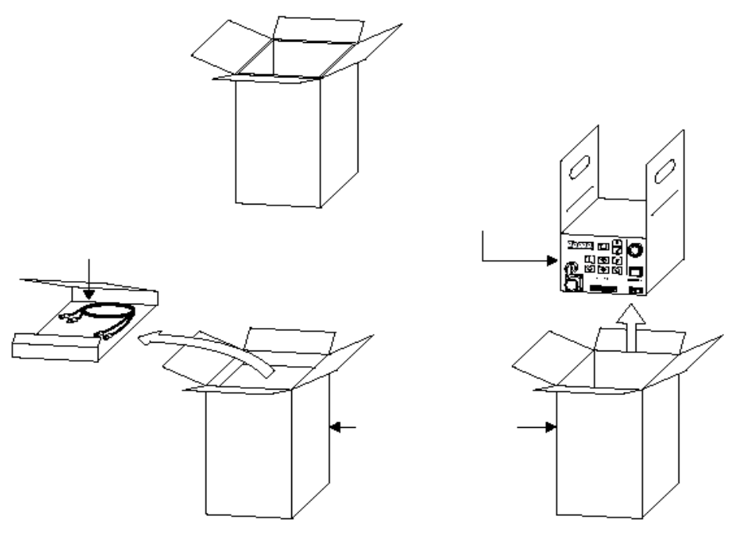
3.1.2 Unpacking the controller
The controller must be unpacked following step 1 to 5.
For future use you should keep the boxes of the robot arm and of the controller
in a safe place, so that you can safely transport the system.
1
5
3
2
4
In case of other controller models, please pay attention to the respective manual!

Slide 41
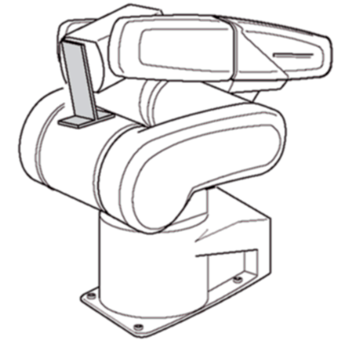
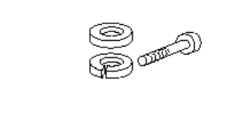
3.1.3 Removing the Transport Securing System
When the robot is ready for being installed, the transport securing system has to be removed.
Do NOT rescrew the bolts of the transport
securing system into the robot arm. Otherwise mechanical damages may be
caused.

Slide 42
3.2 Electrical Connections
- Controller - Power supply
- Controller - Robot arm
- Controller - Teaching box

Slide 43
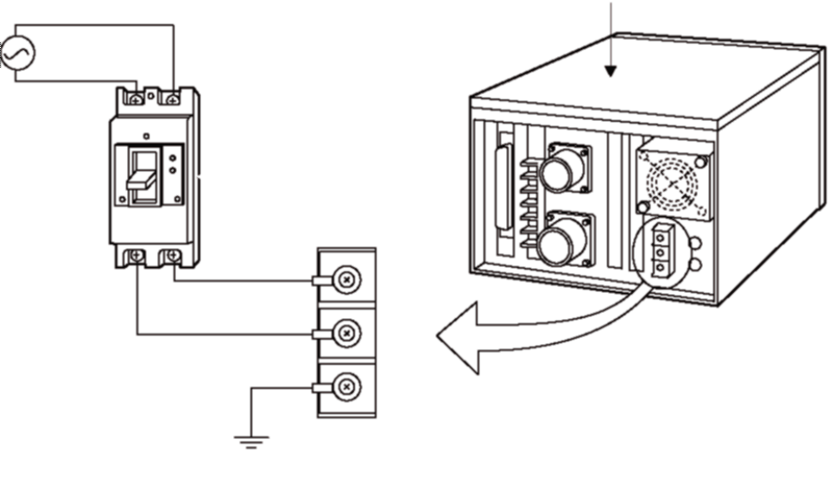
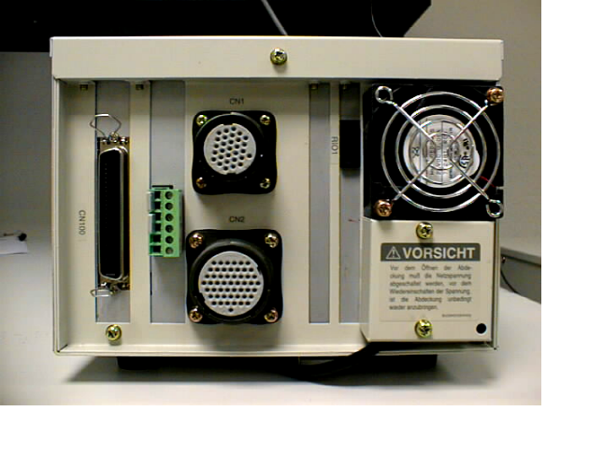
3.2.1 Controller CR1 - Power supply
The controller CR1 can be connected with one single phase (230 VAC) of the
European power supply system without any restrictions.
Power supply
Controller
Earth leakage
circuit breaker
Cramp block

Slide 44
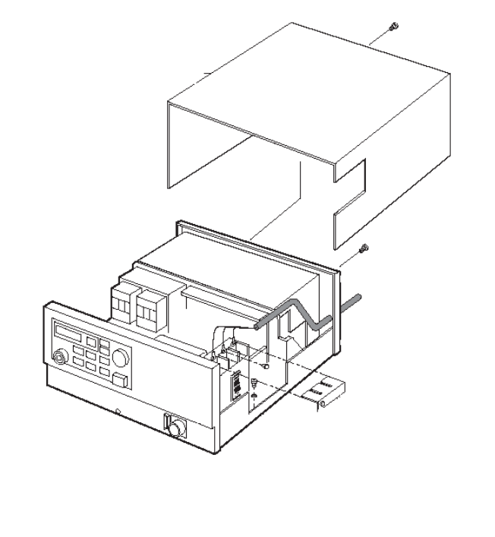
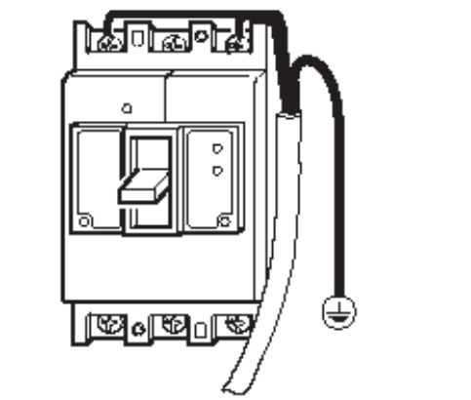
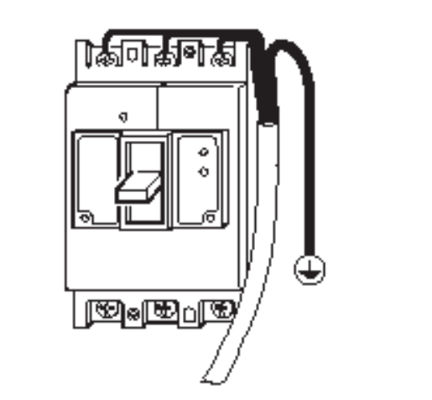
3.2.2 Controller CR2 - Power supply
The controller CR2 can be connected with one single phase of the 230V-net.
If you want to connect the controller with three phases (3 x 400V) of the European
net, you have to use a transformer in order to reduce the voltage to 3 x 200V.
1x 230V
L N
3 x 200V
L1 L2 L3
CR1

Slide 45
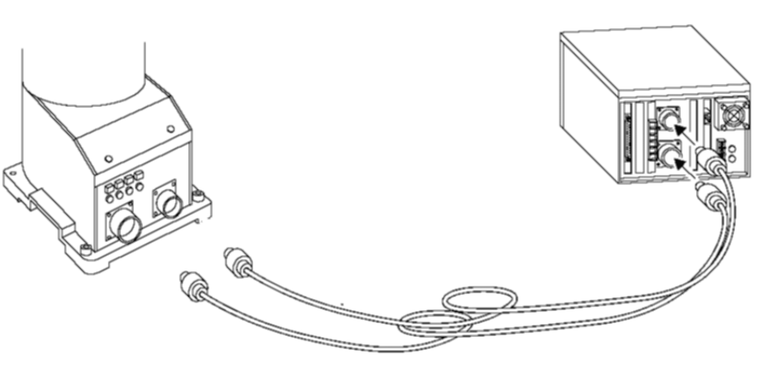
3.2.3 Controller CR1 - Robot arm
Before connecting the controller CR1 with the robot arm, switch off the
controller. Tighten the connectors by means of the screw ring. When you
hear a click, the connection is correct.
Robot arm
Controller CR1
Pay attention that you
do not connect
male to male.
CN1
Control cable
CN2
Power cable

Slide 46
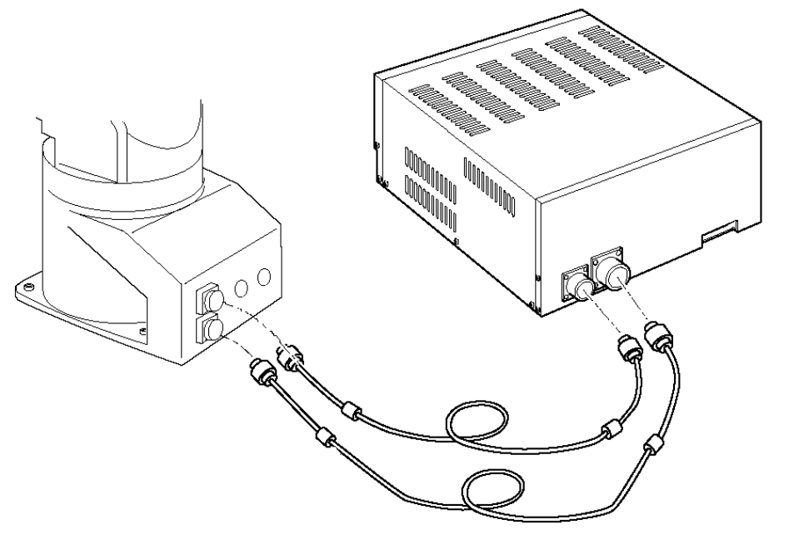
3.2.4 Controller CR2 - Robot arm
The connection of the controller CR2 with the robot arm is exactly the same
as in the case of the controller CR1.
Controller CR2
Robot arm
CN1
CN2
Control cable
Power cable

Slide 47
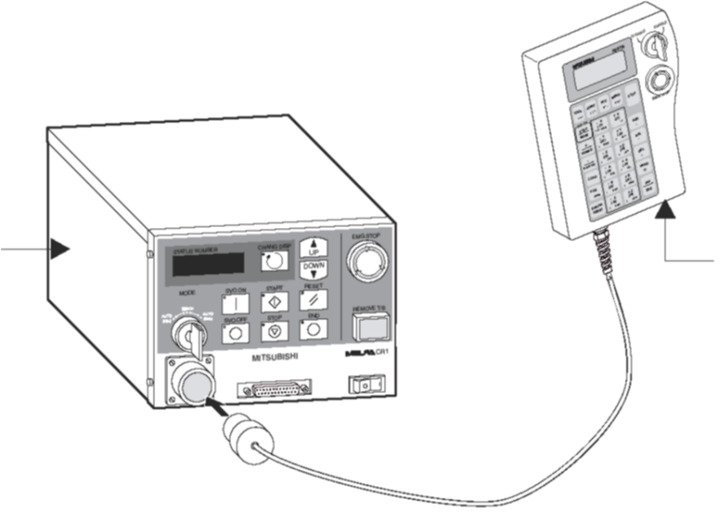
3.2.5 Controller - Teaching box
Connect the cable of the teaching box with the teaching box connection
of the controller.
The connector is fastened by rotating clockwisely the screw ring.
When you hear a click, the connection is correct.
Controller
Teaching box

Slide 48
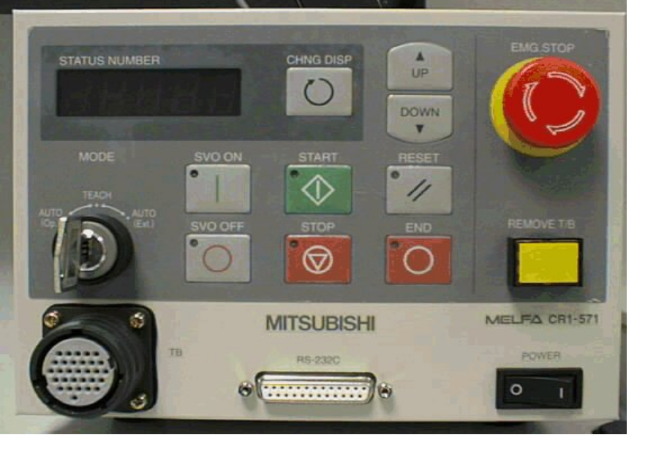
3.3 Control panel and display of the controller
The control panels of the controllers CR-1,CR-2 and CR-2A are identical.
Mode key
Up/Down
Emergency-
5-digit display
Off
Servo ON
Reset
Operating mode
switch
Servo OFF
Emergency-Off
Bridge
For the teaching box
Teaching box
connection
Cycle
Cycle
Cycle
Power switch
start
stop
RS-232C
end

Slide 49
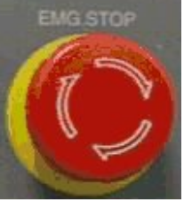
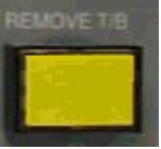
3.3.1 The switches EMG.STOP and REMOVE T/B
EMG.STOP: The clicking switch serves as emergency shutdown of the robot system.
When you press the switch, the moving robot stops immediately. By a clockwise rotation the switch is unlocked.
REMOVE T/B: By means of this switch the emergency shutdown
of the teaching box is bypassed, so that the system can be
operated without teaching box.

Slide 50
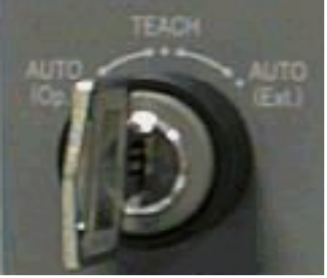
3.3.2 Operating mode switch
AUTO(Op.): The operation is possible only via the controller.
The operation via external signals or teaching box is locked.
TEACH: In case of an active teaching box the operation is possible
only via the teaching box. The operation via external signals or
controller is locked.
Auto(Ext.): The operation is possible only via external signals.
The operation via teaching box or controller is locked.

Slide 51
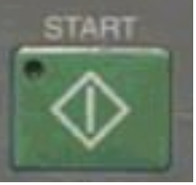


3.3.3 The keys Start, Stop and Reset
START: Starts a program and the operation of the robot, continuous
processing of the program. The green LED lights during the operation.
STOP: Stops the robot program. The servo power supply is not
switched off. The red LED lights during a stop.
RESET: Resets a stopped program and reset to the first command,
acknowledging an error code. The red LED lights if the error is still
present.

Slide 52



3.3.4 The keys END, CHNG.DISP and UP/Down
END: Stops the running programm in the last line or at the END
instruction. The red LED lights in case of cyclic operation.
CHNG.DISP: Changes the display of the controller in the following
order: program number, line number and OVERRIDE. If an error has
occurred and you press the key, the information mentioned above are
displayed in this order.If you do not press the key, the error number is
displayed.
UP/DOWN: Scrolls the display

Slide 53


3.3.5 The keys SVO ON and SVO OFF
SVO.ON: Switching on the servo power supply. The green LED
lights when the servo power supply is on.
SVO.OFF: Switching off the servo power supply. The red LED
lights when the servo power supply is off.

Slide 54



3.3.6 The interfaces and the display
This interface serves to connect the teaching box.
This RS232 interface serves to connect external devices,
for example a PC with COSIROP.
The display (STATUS.NUMBER) indicates alarms, error
numbers and OVERRIDE values.

Slide 55


3.4 Control panel and display of the teaching box
Display
Switch
Movement keys
JOG keys
Deadman
switch
Function keys

Slide 56


3.4.1 EMG STOP and key switch of the teaching box
Pushbutton including locking function for EMERGENCY STOP.
When you press the pushbutton, the robot immediately stops
independently of the respective operating state. To unlock the
pushbutton, rotate the pushbutton.
Allows the control via the teaching box.
For control via the teaching box, set the switch to „ENABLE“.
When the teaching box is active, neither the operation via the
control panel of the controller nor the external operation is possible.

Slide 57

3.4.2 Deadman switch
In case of an active teaching box the servo drive is switched off when the three-
step deadman switch is not pressed or pressed through. To switch on the
servo drive, the deadman switch must be set in mid-position.

Slide 58



3.4.3 The keys TOOL, JOINT, XYZ
Selection of the tool-jog-operation.
Selection of the joint-jog-operation. (This operation mode has to
be selected when the origin data have not been entered yet.)
Selection of the XYZ-jog-operation.

Slide 59



3.4.4 The keys MENU, STOP, SVO ON
Goes to the first menu page.
Stops program execution and robot movement. The key has the
same function as the stop key of the controller. The key is always
available independently of the position of the key switch
(ENABLE/DISABLE).
Executes the jog operation combined with the jog keys, executes
instruction steps combined with the key INP/EXE, switches on the
servo power supply combined with the pressed deadman switch.

Slide 60



3.4.5 The keys FORWD, BACKWD, COND
Executes forward steps combined with the key INP/EXE,
displays the next program line in edit mode, increases the
speed/override combined with the key STEP/MOV.
Executes backward steps combined with the key INP/EXE,
displays the last program line in edit mode, decreases the
speed/override combined with the key STEP/MOV.
Editing the program.

Slide 61



3.4.6 The keys ERROR RESET, ADD, RPL
Resets an alarm,
resets the program combined with the key INP/EXE.
The key ADD serves to input positions or to move the cursor
upwards.
The key serves to change positions or to move the cursor
downwards.

Slide 62



3.4.7 DEL, INP/EXE, POS - Tasten
DEL serves to delete positions or to move the cursor to the left.
Serves to input data or to go to the next step.
Serves to alternate between numbers and characters when editing
the position data.

Slide 63



3.4.8 The keys HAND and JOG
Combined with the key the first gripper hand can be
closed or opened respectively.
Function keys for the jog operation. In joint-jog-operation all
joints can be moved separately. In XYZ-jog-operation the robot
arm can be moved along each of the coordinate axes. By means
of the keys you can also enter the menu selection numbers or
step numbers.

Slide 64

3.4.9 Display
The LCD display (4 lines x 16 characters) indicates the selected program,
the operating state of the robot as well as error messages in clear.

Slide 65
3.4.10 Menu structure
<MENU>
<TEACH>
1 or [INP/EXE]
1.
Teach
2. Run
6 or [
↓
]
<SET>
3. File
4.
Moni
.
1.
Clock
(
)
5.
Maint
.
6. Set
Select Program
2 or [
↓
]
5 or [
↓
]
<RUN>
<MAINT.>
1.
Param
1.
Servo
2. Check
.
2.
Init
3.
Brake
4.
Origin
3 or [
↓
]
4 or [
↓
]
5. Power
<FILE>
<MONI>
1. Dir
2.
Copy
1. Input
2. Output
3.
Var
3.
Rename
4.
Delete
.
4.Alarm
5.
Reg
.

Slide 66
3.4.11 Reading out the software versions
Teaching box: During the booting of the controller the display of the
teaching box indicates at the upper right the software version
of the teaching box.
Operating system: After the controller has been booted, the display
of the teaching box indicates at the upper right the software version of the
operating system of the controller.

Slide 67
3.5 Switching on the robot system
1. Check whether the following Emergency-Stop-switches are not pressed:
- on the teaching box
- on the controller
- possibly an additional Emergency-Stop-switch
2. Ensure that the yellow key switch marked with REMOVE T/B is not
pressed.
3. Leave the range of the robot arm.
4. Switch on the power switch of the controller.

Slide 68


3.6 Setting the ORIGIN position
By the setting of the ORIGIN position all axes of the robot are adjusted to one
defined point. This adjustment is very important, because it is decisive for the
later positioning. The ORIGIN point is the reference point for all calculations of
the positions to be reached.
If the ORIGIN position is not set,
the robot can be used only in
JOINT mode!

Slide 69
3.6.1 Setting the ORIGIN position
Methods
There are 3 relevant methods to set the ORIGIN position:
Data: Setting by means of predefined data
TOOL: Setting by means of calibrating device
Mech: Setting by means of mechanical stoppers
The menu of the teaching box offers 2 additional possibilities, but they
are not used.
User: Not used
ABS: Not used

Slide 70


3.6.2 Proceeding of the DATA method (1)
In case of the DATA method the specific data of the robot arm are input via
the teaching box. Before the input these values have been defined by means of
the calibrating device!

Slide 71


3.6.2 Proceeding of the DATA method (2)
You find the data on a sticker on the inside of the cover of the battery case or on
an additional paper enclosed with the manuals.
Before opening the battery case, switch off
the power of the robot!
Now, connect the teaching box with the controller and switch on the teaching box.

Slide 72

3.6.2 Proceeding of the DATA method (3)
In the menu of the teaching box you select now the DATA method and switch off
the servos (as shown in the following).

Slide 73


3.6.2 Proceeding of the DATA method (4)
The example on the right shows how to
input the data of the additional paper
enclosed with the manual.

Slide 74

3.6.2 Proceeding of the DATA method (5)
After the input of the data switch off the controller. Then
switch on the controller. Now the data are stored.

Slide 75

3.6.3 Proceeding of the TOOL method (1)
In case of the TOOL method the reference position of the robot is defined
by means of the calibrating device.
This method is the most exact possibility to reference the robot!
+
Important! Enter the new values in the data sheet.

Slide 76

3.6.3 Proceeding of the TOOL method (2)
Mount at first the
calibrating device !

Slide 77

3.6.3 Proceeding of the TOOL method (3)
In the menu of the teaching box you select now the TOOL method and switch off
the servos (as shown in the following).

Slide 78

3.6.3 Proceeding of the TOOL method (4)
Take off the brakes via the teaching box (as shown in the example).
Since the axes are now unbraked, ensure that the axes are secured by a
second person!

Slide 79


3.6.3 Proceeding of the TOOL method (5)
Position the calibrating device according to the robot model!
In case of robot models which are not shown here see the delivered manual
for information concerning position and type of the calibrating device.

Slide 80

3.6.3 Proceeding of the TOOL method (6)
After the calibrating device has been adjusted exactly you finish the setting with
the following steps.
Demount the calibrating device!

Slide 81
3.6.3 Proceeding of the TOOL method (7)
Demount the calibrating device!
Important! After the setting has been finished enter the new values
in the data sheet.

Slide 82
3.6.4 Proceeding of the MECH method (1)
In case of the MECH method the reference positions of the single robot
axes are defined accordingly to the mechanical stoppers.
Advantage: It is possible to define the reference value for each axis.
Disadvantages: This type of referencing is not very exactly.
=> Each adjustment causes a different position of the axis!
This adjustment type is not possible for all robots.
=> see the respective manual

Slide 83

3.6.4 Proceeding of the MECH method (2)
In the menu of the teaching box you select now the MECH method and switch off
the servos (as shown in the following).

Slide 84


3.6.4 Proceeding of the MECH method (3)
The examples below show the menus for selecting the brakes and axes.
5 axes
6 axes
Since the axes are now unbraked, ensure that the axes are secured by a
second person!

Slide 85


3.6.4 Proceeding of the MECH method (4)
This example shows the setting of axis 1
(J1). For the other axes proceed
correspondingly.
Referring to :
For information how to position the single
axes of the different robots, see the
respective manual.

Slide 86
3.6.4 Proceeding of the MECH method (5)
Important! After the setting has been finished, enter the new
values in the data sheet.

Slide 87
4. Moving the Robot

Slide 88

Moving the robot arm
And it moves after all!
When the robot moves for the first time, the following has to be taken into
account:
- If the ORIGIN position has not been set yet, the robot can be moved only in
JOINT mode!
- Software end switches are not yet active!
Attention, mechanical damages may occur!

Slide 89

Moving the robot arm
To move the robot arm, the teaching box has to be connected with the controller
and the teaching box must be switched on.
=> The key switch must be put in the teaching box and set to ENABLE.

Slide 90




Moving the robot arm
Key combinations
After the teaching box has been connected, the following keys have to be
pressed simultaneously:
+
+
=
Servo On + Deadman switch + Movement keys

Slide 91
5. Teaching

Slide 92
5.1 Coordinate systems (1)
Concerning robot systems there are the following different coordinate systems: world coordinate system, basic coordinate system, and tool coordinate system.
These coordinate systems will be described in detail on the following pages.

Slide 93
5.1 Coordinate systems (2)
A three-dimensional Cartesian coordinate system consists of three coordinate axes x, y, z
which are orthogonal in pairs (normal) and have one common point U (origin of coordinates). The three coordinate axes are named as follows (Right Hand):
-> When you view against the z-axis, the axes x and y form a plane Cartesian coordinate system in the xy-plane.
-> When you view against the x-axis, the axes y and z form a plane Cartesian coordinate system in the yz-plane.
-> When you view against the y-axis, the axes z and z form a plane Cartesian coordinate system in the zx-plane.
z
U
x
y

Slide 94

5.1 Coordinate systems (3)
+Zw
Tool coordinate
reference point
Yt
Zt
+Yw
Xt
Zb
Yb
Robot basic
reference point
World coordinate
reference point
Xb
+Xw

Slide 95
5.1 Coordinate systems (4)
World coordinate system : This system is in accordance with the Cartesian coordinate system and thus with the human imagination; we think and act according to this system.
Basic coordinate system: Identical with the world coordinate system; the only difference is that the origin of the basic coordinate system is in the foot of the robot arm.
Tool coordinate system : This system is also a Cartesian coordinate system; its origin is not in the robot foot, but in the flange plate of the robot arm. By each rotation or three-dimensional change of the gripper flange the orientation of the coordinate system changes.

Slide 96
5.2 Modes of Movement
5.2.1 Joint : In case of this mode each axis of the robot arm can be moved individually.
5.2.2 X-Y-Z : In case of this mode the gripper point of the robot (Tool Center Point) is moved in the Cartesian coordinate system.
5.2.3 Tool : In case of this mode the basis of the Cartesian coordinate system is in the gripper point of the robot (TCP).
Z
Cartesian coordinate system :
X
Y

Slide 97


5.2.1 Joint
(J4) Forearm
(J5) Wrist
(J6) Gripper
hand
(J3) Elbow
(J2) Shoulder
(J1) Basis

Slide 98


5.2.2 X-Y-Z
-
+
X
Z
+
-
-
Y
+
TCP

Slide 99

5.2.3 Tool
+X
-Y
+Y
-X
+Z

Slide 100

5.2.4 Tool Center Point
TCP
(Tool Center Point)
Y‘=65mm
Y
Z‘=145mm
Z
X

Slide 101





5.3 Articulated-arm robots and SCARA robots: Differences of the modes of movement (1)
Due to their mechanical structure the single robot models offer in some cases very different possibilities to move.

Slide 102
5.3 Articulated-arm robots and SCARA robots: Differences of the modes of movement (2)
In case of the SCARA (Selective Compliance Assembled Robot Arm) robots a maximum of 4 axes can be used to realize a sequence of movements. The orientation of a mounted gripper can be changed only in a plane (2D).
Z
A
X
Y

Slide 103
5.3 Articulated-arm robots and SCARA robots: Differences of the modes of movement (3)
The articulated-arm robots offer up to 6 degrees of freedom to realize a sequence of movements. The orientation can be changed in three dimensions (3D).
Z
5 axes
X
Z
Y
X
6 axes
Y

Slide 104
5.4 Programming by means of the teaching box (1)
Position data are taught by means of the teaching box. These position data are stored in a defined memory area of the controller.
Later a robot program is created by means of a PC. This robot program links the position data to a sequence. This sequence must also be stored in the controller.

Slide 105
5.4 Programming by means of the teaching box (2)
Now the controller has to link the position data with the program.
This linking is realized via the program names.
Ensure that a robot program and its belonging position list have identical names.
To simplify the input of the program name and the representation in the display of the teaching box, select a program number.

Slide 106

5.4 Programming by means of the teaching box (3)
Set the key switch to „Enable“.

Slide 107

5.4 Programming by means of the teaching box (4)
After you have pressed once the key „Menu“ the main display appears. The further sequence is as follows:

Slide 108


5.5 Storing the position by means of the teaching box (1)
After you have pressed the key combination [POS] and [ADD], the display changes into the edit mode for the position data.

Slide 109

5.5 Storing the position by means of the teaching box (2)
When the robot has reached the end position, this position must be stored.

Slide 110


5.6 Reaching a position by means of the teaching box (1)
The TCP of the robot can be moved to a position which has already been taught.
After the position to be reached has been selected and the deadman switch has been pressed, the robot moves.

Slide 111


5.6 Reaching a position by means of the teaching box (2)
When the movement is finished, you can release the key
When the end position has been reached, the position including its new position number has to be stored.
5
5

Slide 112
6. Melfa Basic IV

Slide 113
6.1 Definition
Melfa Basic IV is a robot programming language especially developed for Mitsubishi robots. By means of this programming language you can for example structure the robot movement or realize many special functions, for example calculations. Melfa Basic IV leans very closely upon the programming language „Basic“ which is well known since many years. The number of functions of both programming languages is similar.

Slide 114
6.2 Commands (1)
In the following there is a list of commands very often used:
MOV (Move) : Axial interpolation of the robot arm
MVS (Move Straight) : Linear interpolation of the robot arm
DLY (Delay) : Delay in seconds
END (Program End) : End of a program cycle
CNT (Continuous) : Continuous movement
HOPEN (Hand Open) : Open a gripper hand
HCLOSE (Hand Close) : Close a gripper hand

Slide 115
6.2 Commands (2)
ACCEL : Acceleration and deceleration of robot movements
JOVRD : Axially interpolating speed (for MOV)
SPD : Linearly interpolating speed (for MVS)
OVRD (Override) : General speed overriding in %
M_IN(bit number) = Status: input bit declaration
M_OUT(bit number) = Status: output bit declaration

Slide 116
6.2 Commands (3)
Special features :
Apostrophe (´)
In a robot program comment lines are marked by an apostrophe.
The comment lines are transferred to the robot controller.
Example: 100 ´Pick position
Blank ( )
A blank has to be set between commands, single data and after line numbers.
Example: 100 MOV P10

Slide 117
6.3 Program structure (Syntax)
A robot program consists of several program lines. The structure of a program line is as follows:
Line number Command ‘ Comment
10 MOV P1 ‘ Start position
20 MOV P2 ‘ Above pick position

Slide 118
6.4 Programming Examples

Slide 119
6.4.1 MOV Programming example
Axial interpolation
The robot moves between two positions on a path defined by the controller in order to cover as quickly as possible the distance between A and B.
10 MOV P1 ‘ axially interpolating movement to position 1

Slide 120
6.4.2 MVS Programming example
Linear interpolation
The robot moves between two positions on a linear path calculated by the controller. This shortest path is not the quickest path, because the controller has to move more axes to realize the movement in comparison with the axial interpolation.
10 MVS P11 ‘ linearly interpolating movement to position 11

Slide 121

6.4.3 ACCEL Programming example
10 ACCEL 100,50 ‘ 100 means 100% = 0.2s acceleration; ‘ 50 means 200% = 0.4s deceleration
20 MOV P1 ‘ axially interpolating movement to position 1
30 MOV P2 ‘ axially interpolating movement to position 2
Formula for calculating the acceleration-deceleration time:

Slide 122
6.4.4 END Programming example
10 MOV P1 ‘ axially interpolating movement to position 1
20 MOV P2 ‘ axially interpolating movement to position 2
30 END ‘ Program end

Slide 123
6.4.5 CNT Programming example (1)
The robot moves continuously between positions. A certain distance before reaching and after leaving the end position is defined as oversliding. Example:
The robot movement deviates from the calculated path 200 mm before reaching the end position P3. The robot movement returns to the new path 300 mm after the end position.
P2
P1
200 mm
P3
300 mm

Slide 124
6.4.5 CNT Programming example (2)
10 CNT 0 ‘ switching off the continuous movement
20 MOV P1 ‘ axially interpolating movement to position P1
30 MOV P2 ‘ axially interpolating movement to position P2
40 CNT 1,200,300 ‘ switching on the continous movement
50 MVS P3 ‘ linear movement to position P3
60 CNT 0 ‘ switching off the continuous movement
70 END ‘ program end

Slide 125
6.4.6 DLY Programming example
10 MOV P20 ‘ axial interpolation to position P20
20 DLY 4 ‘ delay of 4 seconds
30 MOV P78 ‘ axial interpolation to position P78
40 M_OUT(6) = 1 DLY 2 ‘ sets output bit 6 for 2 seconds to „1“

Slide 126
7. COSIROP

Slide 127

7.1 Definition
  Programming software for Mitsubishi industrial robots
COSIROP is a tool for programming, online operation, parameterizing and diagnosis of
Mitsubishi robots. By means of COSIROP you can create robot programs using
Movemaster Command or MELFA Basic and exchange these robot programs
between PC and robot controller via the serial interface. Additionally, you can edit
and exchange position lists.

Slide 128
7.2 HARDWARE requirements
- 133 MHz Pentium II PC
- 32 MBytes RAM
- 80 MBytes available disk space
- 3.5" floppy disk drive or CD-ROM
- Mouse
- Windows 95/98/ME, Windows NT 4.0 or Windows 2000
- A free serial interface (COM1 ... COM4) for connecting the robot controller
- A parallel interface for the dongle

Slide 129
7.3 Installation
COSIROP is a programming software protected by a dongle.
The dongle for the parallel port is delivered with the COSIROP CD.
In general this dongle is plugged in LPT1.
Since new PCs do not have parallel ports any more, also
USB dongles are available.

Slide 130

7.3 Installation (1)
The program SETUP generates all necessary directories and copies all necessary
data. To install COSIROP, start "SETUP.EXE" included in the root directory of your
CD-ROM disk. Follow the instructions displayed on the screen in the following.
At first the COSIROP setup installs
a system driver for the dongle
(hardlock, connector for protecting the
software against copying) and then
restarts the PC. After this, you have to
start "SETUP.EXE“ again. When
"SETUP.EXE“ has been started, the
following dialogue is displayed:

Slide 131

7.3 Installation (2)
To cancel the installation, click on the button “Cancel“. To continue the installation,
click on the button “Continue >“. Now, the following dialogue is displayed:
Enter your name and your company name
and then click on the button “Continue >".
If you had installed COSIROP before this, only
the registration information is displayed.

Slide 132

7.3 Installation (3)
Now you can select the installation directory:
To exclude errors, deinstall at first the “old“ version before you install a “new“
version!
If you want to select another directory, click on
the button “Search...“. Then another dialogue
appears in which you can select another
directory or enter the directory. Continue the
installation by clicking on the button
“Continue >“. Select a program manager
group or the entry included in the start menu of
Windows X or Windows NT 4.0.

Slide 133

7.3 Installation (4)
Select a program manager group or the entry included in the start menu of
Windows 95/ 98/ 2000/ XP or
Windows NT 4.0.
Click again on the button “Continue >".
Now, all necessary information are available
to install COSIROP.

Slide 134

7.3 Installation (5)
Up to now no files (except the system drivers for the dongle) have been copied to
the hard disk. This is the last possibility to cancel the installation by clicking on the
button “Cancel". To continue the
installation, click on the button
“Continue >".

Slide 135

7.3 Installation (6)
Now the SETUP program copies the files
to the hard disk of your PC. While doing so
the progress of the installation is displayed.

Slide 136

7.3 Installation (7)
After this the installation is finished.
For confirming you have to click on the button
“Continue".
  Now you can start COSIROP for the first time. To start COSIROP, select
  "COSIROP“ in the start menu.

Slide 137

7.4 The first project (1)
After COSIROP has been opened, the following screen appears:
- When you click on “File“,
a pull-down-menu is opened.

Slide 138

7.4 The first project (2)
For opening the project assistant, click on “New Project“.
The following window appears:

Slide 139

7.4 The first project (3)
Enter here the project name to be
saved.
When the window is opened, the
default setting is UNTITLED.

Slide 140

7.4 The first project (4)
Enter the program name. Under
this program name the program
is transferred to the controller.

Slide 141

7.4 The first project (5)
By clicking on the button “Search“
you can select the directory in which
the project is to be stored.
The „Directory“ indicates the path
where the project is stored.

Slide 142
7.4 The first project (6)
Here you can enter the name of
the author.
Here you can enter the author‘s
initial letters.
Here you can enter additional
information.

Slide 143

7.4 The first project (7)
Click on the button “Continue“ to
open the next page.

Slide 144

7.4 The first project (8)
Here you select the
robot model.
After you have selected the robot
model, a graphic of this robot is
displayed.

Slide 145

7.4 The first project (9)
If you use linear axes, here you
have to select the used axes.
Here you have to select the
programming language to be used
for programming.

Slide 146
7.4 The first project (10)
If additional I/O cards are used, you
have to select these cards here.
If grippers are used, they have to
be selected here.
Click on the button “Continue“ to
open the next page.

Slide 147

7.4 The first project (11)
On this page you can take
notes about changes.
Click on the button “Finish“ to
open the next page.

Slide 148

7.4 The first project (12)
This window shows the
orientation of the robot
related to the respective
position.
This window displays the position data which have been taught and
loaded.

Slide 149
7.4 The first project (13)
Here you can edit
the program.
This window
displays messages.

Slide 150
7.5 Programming (1)
By means of the commands described in the previous chapter you can program the robot for example to pick and place something or to check something.
The following programming example makes the robot pick and place something. All details directly result from the example.

Slide 151

7.5 Programming (2)
In case of COSIROP a command line begins always with a number.
In the first line the number has to be entered by hand. The following lines are
automatically provided with numbers after you have pressed the Return key.

Slide 152


7.5 Programming (3)
Task:
An object should be picked and then placed at another position. For this at first 4 positions have to be taught:
Above pick position (P1)
Pick position(P2)
Above place position (P3)
Place position (P4)
X

Slide 153
7.5 Programming (4)
List of the used commands:
MOV : axially interpolating movement to position Pxx
MVS : linearly interpolating movement to position Pxx
DLY : delay in seconds
HOPEN : open a gripper hand
HCLOSE : close a gripper hand
END: end of the program

Slide 154
7.5 Programming (5)
Programmed movement sequence :
10 HOPEN ‘ open the gripper
20 MOV P1 ‘ above pick position of the component
30 MVS P2 ‘ pick position of the component
40 DLY 1 ‘ delay 1 second, until next action starts
50 HCLOSE ‘ close the gripper
60 DLY 1 ‘ delay 1 second, until next action starts
70 MVS P1 ‘ pick the component
80 MOV P3 ‘ above place position of the component
90 MVS P4 ‘ place position of the component
100 DLY 1 ‘ delay 1 second, until next action starts
110 HOPEN ‘ open the gripper
120 DLY 1 ‘ delay 1 second, until next action starts
130 MVS P3 ‘ above place position of the component
140 END ‘ end of the program

Slide 155

7.6 UPLOADING/DOWNLOADING (1)
To transfer programs/positions between PC and controller, the programs/positions
have to be uploaded/downloaded.
The controller‘s interface is preset.
The PC‘s interface has to be set as shown in the following:
The controller‘s key switch must be set to AUTO(Ext)!

Slide 156

7.6 UPLOADING/DOWNLOADING (2)
To set up the hardware connection, you need the interface
cable RV-CAB4.

Slide 157


7.6 UPLOADING/DOWNLOADING (3)
At first click on the key symbol to set up the connection between PC and controller.
After the connection has been set up, the following window appears on the
screen:
Click on the button OK and the window
will be closed.

Slide 158
7.6 UPLOADING/DOWNLOADING (4)
The connection has been set up when the key symbol is „pressed“.
DOWNLOAD
UPLOAD
In addition to some other buttons the buttons for
downloading and uploading are now also available.

Slide 159
7.6 UPLOADING/DOWNLOADING (5)
Important: In case of a download or upload the window with the data you want
to download or upload must be active!
Program
window active!
Window with position
data active!

Slide 160

7.6.1 UPLOADING/DOWNLOADING a program (1)
To activate the program window, left-click into the window.
Program window
active!

Slide 161

7.6.1 UPLOADING/DOWNLOADING a program (2)
When you click on the download button, the following window
appears.
Select „Delete all when downloading“. By this you
delete all program data stored in the memory location
of the controller to be used for the new data.
Enter the number of the memory location where the
program is to be stored within the controller.
To start the transfer, click on the button OK.

Slide 162

7.6.1 UPLOADING/DOWNLOADING a program (3)
When you click on the upload button, the following window
appears.
Enter the number of the memory location
where the program is stored within
the controller.
To start the transfer, click on the button OK.

Slide 163

7.6.2 UPLOADING/DOWNLOADING position data (1)
To activate the position data window, left-click into the window.
Position data window
active!

Slide 164

7.6.2 UPLOADING/DOWNLOADING position data
When you click on the download button, the following window
appears.
Enter the number of the memory location where the positions are to be stored in the controller.
To start the transfer, click on the button OK.

Slide 165

7.6.2 UPLOADING/DOWNLOADING position data (1)
When you click on the upload button, the following window
appears.
Enter the number of the memory location
where the positions are stored within
the controller.
To start the transfer, click on the button OK.

Slide 166

7.6.2 UPLOADING/DOWNLOADING position data (2)
When the position data have been uploaded successfully, the position
data window displays the position data.
Attention: If there had been a position list before, this list is overwritten.

Slide 167

It was not as bad as all that, was it?
We would be pleased about your
participation in the next course !!

